Slide 1
State of Michigan
Center for Shared Solutions
Department of Technology, Management and Budget
Overview Presentation
Data Transparency 2016
Washington, D.C.
Rob Surber
September 28, 2016

Slide 2






State of Michigan
Vision to Transform Service Delivery to Citizens
EIM transforms the way the State of Michigan delivers services to its citizens
Citizens
1
The State of Michigan offers programs and services to its citizens.
Key Performance Indicators (KPIs) are defined by the business and supported by the ASC. They measure program effectiveness through metrics, scorecards and dashboards.
ASC works in partnership with department analytic specialists to provide the intelligence to make better decisions about state programs and to answer questions posed by the Governor and department leadership.
EIM program elements rationalize, organize, sustain and present information to the ASC.
State departments and third parties provide cleansed data to the EIM.
The organizational processes, principles, model, roles and responsibilities are the foundation to sustain EIM.
1
State Program
State Program
State Program
2
KPI(s)
KPI(s)
KPI(s)
2
Analytics Service Center (ASC)
3
EIM Program Elements
3
4
Dept. 1
Dept. 2
Dept. N
4
5
5
Foundation
Principles
Security
Data Quality
6
Share First
Governance
Privacy
6
2

Slide 3


State of Michigan
Enterprise Information Management Program
To continue the process of reinventing the state government and transforming how it serves its citizens, it is crucial to transform the way the branches of the government operate internally to manage their vast and valuable state information assets.
Governor Snyder’s vision of EIM proposes to enable the following capabilities for the citizens and the state operations.
Enhanced Customer Experience
Increased Transparency
Improved
Government Operations
Greater Insights
and Intelligence
Integration of citizen data across departmental siloes to know and serve the customer better.
Enabling single sign on for all government programs and interaction
Strengthen data foundation, enhance the open data portal.
Identification of data as public, open and available
Seamless and streamlined protocol for cross-departmental data sharing.
Bring disparate agencies together by building data-centric communities, cohorts and groups
Generate analytical insights easily and efficiently by correlating and aggregating data across agencies
It is only possible to drive real transformation if the State has an Integrated Information model that enables easy access to information about who its people are, where its businesses are located , how its geographies are divided, how its citizens are served.
3
Notes:
Add slide for program synopsis

Slide 4



Program Synopsis: EIM at Michigan Today
1
EIM is a set of state-wide solutions
3
EIM is the State’s ‘data integration’ vehicle and the data foundation layer to multiple state projects
Integrated Service Delivery
21CN Infrastructure
Identity Master
Traffic Fatalities Reduction
MiPage
Location Master
Open Data
Business Glossary
Citizen Services
Enterprise Data Services
2
EIM is building a set of statewide repositories
EIM is a Program Team – Steering Committee,
Project Managers, Program Teams
Enterprise Information Management
Citizen Master Repository
Location Master Repository
Data Dictionary and Metadata Repository
5
EIM is a guidance and consulting service
Through its experiences and connections, EIM is able to provide guidance and consulting services to all departments, agencies or offices that need help with ‘data matters’:
Could be about Analytics
Could be about cross-agency data integration or data sharing.
Could be about managing and organizing data
Could be about setting up departmental data governance.
Or setting up programs on any of the topics listed on this slide
4
EIM is a methodology
The data component of all projects should be formalized
6

Slide 5

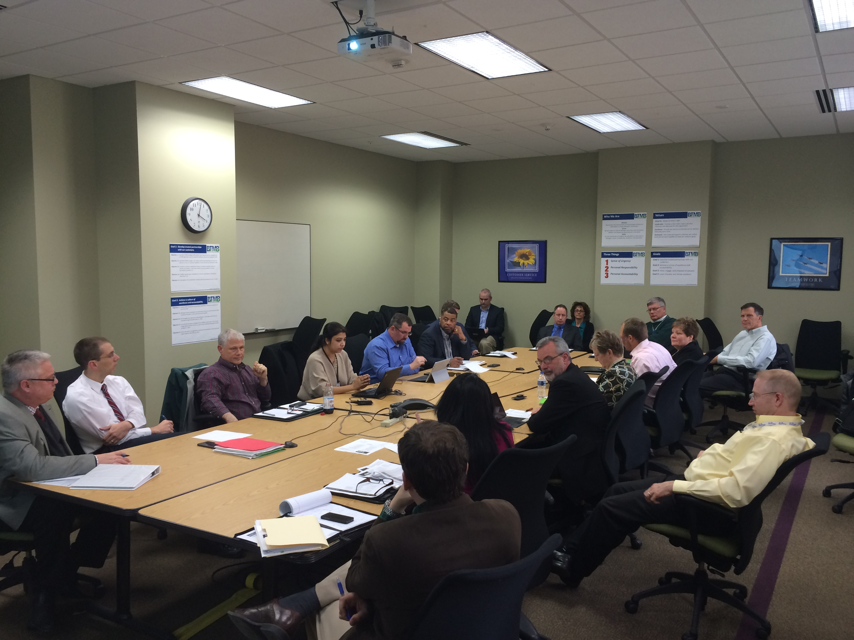
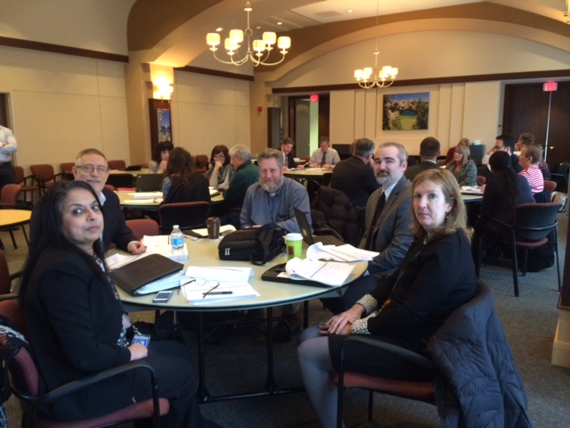
Chief Data Stewards
Chief Data Stewards and their data teams at work
Chief Data Steward Forum
5
Notes:
MM Note: I changed “Form” to “Forum” in the title

Slide 6
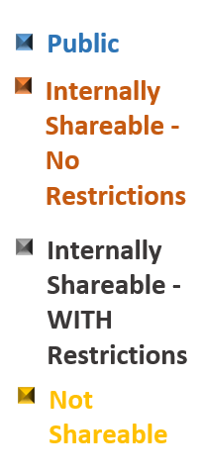
Data Shareability
6

Slide 7
Department Data Inventory
Center for Educational Performance and Evaluation (CEPI)
Data Group | Level | Description | Your Agency/Division/Section/Unit | Statutory or Regulatory Limitations may impact distribution with an explanation | Information System (ex: HRMN, DCDS) | Shareability Category (Please select from one of the dropdowns) | Shareability Comments (Please provide any comments for your choice, as needed)
o Early Childhood | L1 | Educational data for early childhood students that are participating in specific programs. | DTMB/CEPI |  | MSDS Early Childhood | Internally Shareable - WITH Restrictions
Early Childhood Student | L2 | Educational data for children from birth to school age. This data is used to report specific programs in which early childhood students are participating. | DTMB/CEPI | Family Educational Rights and Privacy Act (FERPA) | MSDS Early Childhood | Internally Shareable - WITH Restrictions
· Core field identification | L3 | Student identification data. | DTMB/CEPI | Family Educational Rights and Privacy Act (FERPA) | MSDS Early Childhood | Internally Shareable - WITH Restrictions
· Demographics | L3 | Student demographic data. | DTMB/CEPI | Family Educational Rights and Privacy Act (FERPA) | MSDS Early Childhood | Internally Shareable - WITH Restrictions
· Enrollment | L3 | Student enrollment data. | DTMB/CEPI | Family Educational Rights and Privacy Act (FERPA) | MSDS Early Childhood | Internally Shareable - WITH Restrictions
· Early Childhood Programs | L3 | Program data for students participating in early childhood programs and services. | DTMB/CEPI | Family Educational Rights and Privacy Act (FERPA) | MSDS Early Childhood | Internally Shareable - WITH Restrictions
· Early Childhood Special Education Assessment | L3 | Enrollment and exit assessment data for students from age 2 1/2 years through 6 years 1 month of age with disabilities who receive special eduction programming or services. | DTMB/CEPI | Family Educational Rights and Privacy Act (FERPA) | MSDS Early Childhood | Internally Shareable - WITH Restrictions
· Early On | L3 | Data collected for students with special needs that receive Early On services. | DTMB/CEPI | Family Educational Rights and Privacy Act (FERPA) | MSDS Early Childhood | Internally Shareable - WITH Restrictions
o K-12 | L1 | Educational data for students, staff and entities from kindergarten and the 1st through 12th grade. | DTMB/CEPI | Family Educational Rights and Privacy Act (FERPA), State School Aid Act
K-12 Student | L2 | Educational data for students from kindergarten and the 1st through 12th grade. | DTMB/CEPI | Family Educational Rights and Privacy Act (FERPA), State School Aid Act | Michigan Student Data System (MSDS) | Internally Shareable - WITH Restrictions
· Core field identification | L3 | Student identification data. | DTMB/CEPI | Family Educational Rights and Privacy Act (FERPA), State School Aid Act | Michigan Student Data System (MSDS) | Internally Shareable - WITH Restrictions
· Demographics | L3 | Student demographic data. | DTMB/CEPI | Family Educational Rights and Privacy Act (FERPA), State School Aid Act | Michigan Student Data System (MSDS) | Internally Shareable - WITH Restrictions
· Enrollment | L3 | Student enrollment data. | DTMB/CEPI | Family Educational Rights and Privacy Act (FERPA), State School Aid Act | Michigan Student Data System (MSDS) | Internally Shareable - WITH Restrictions
· Membership | L3 | Student residency and eligibility for full-time equivalency (FTE). | DTMB/CEPI | Family Educational Rights and Privacy Act (FERPA), State School Aid Act | Michigan Student Data System (MSDS) | Internally Shareable - WITH Restrictions
· Attendance | L3 | Student possible and actual attendance for a school year. | DTMB/CEPI | Family Educational Rights and Privacy Act (FERPA), State School Aid Act | Michigan Student Data System (MSDS) | Internally Shareable - WITH Restrictions
· General Education FTE | L3 | Student district general education residency. | DTMB/CEPI | Family Educational Rights and Privacy Act (FERPA), State School Aid Act | Michigan Student Data System (MSDS) | Internally Shareable - WITH Restrictions
· Program Participation | L3 | Student eligibility and/or participation in specialized prograsm or services. | DTMB/CEPI | Family Educational Rights and Privacy Act (FERPA), State School Aid Act | Michigan Student Data System (MSDS) | Internally Shareable - WITH Restrictions
7
Notes:
A snapshot of the spreadsheet

Slide 8




EIM Data Analytics “67 Use Cases”
Analytics Microstudies
EIM developed analytic micro-studies or “use cases” to identify new insight, value and decision support for participating departments. Use cases were designed to blend data across departments and with other publicly available data sets.
These “tip of the iceberg,” style analyses portray immediate value of data-driven insights while paving the way for deeper research capable of impacting departmental policy and delivery of services.
Chronic Absenteeism and Neighborhood Health
Investigating hypothesized correlation between an impoverished neighborhood, and the number of children in the school that have irregular attendance.
Job Loss and Job Growth Projection Trends and workforce Training
Exploring Relationships between Michigan’s job loss and job growth projection trends with those completing workforce training
Increase Online Marketing Intelligence, Resource Targeting & Customer Service
Building Zip Code Level ‘ExpressSOS’ user typologies in Michigan. Identify distinct differences in user types that can be used for new insight and decision support by Department of State leadership to increase ‘ExpressSOS’ marketing intelligence, resource targeting and customer service.
Age and Sales Price of Homes with Asthma Hospital Visits
Homes built before 1940s or lower value homes are strongly correlated with increased levels of asthma events needing a hospital visit.
Zip Code Level Spatial Typologies for Treasury Audits
Increase insight and decision support related to spatially equitable distribution of audits and targeting audits for optimal identification of deficient businesses in Michigan.
3rd Grade Reading Proficiency
3rd Grade Reading Proficiency and correlation with home location, gender, poverty indicators, chronic absenteeism rates, language/immigration/special education status , health of the immediate area surrounding a child’s home (occupancy/housing market/blight/crime).
Identify Population Concentrations at Risk of Losing Emergency Services in Flood Events
GIS Bridge Scour and Flood Analysis in Genesee County, MI– chosen because of mix of highest number of bridges at risk of scour and high population density
Customer Profiles for Michigan’s DNR License purchases
Increased knowledge about the attributes and behavior of DNR customers is critical for purposes of increasing DNR customer service and marketing intelligence as well as insuring strong continuity of a healthy Michigan hunting and fishing industry. Zip Code Level spatial analysis of customer, licensing and socioeconomic attributes was conducted.
Build Insight for strategies to reduce Drug Overdose Deaths in Michigan
Exploring relationships between drug supplier & consumer arrests with drug Overdose in Michigan’s Counties
8

Slide 9
Age of Homes vs. Asthma Prevalence in Detroit, MI
Table 1: Age of Homes vs. Asthma Prevalence
Chart 1: Age of Homes vs. Asthma Prevalence
Average Year Built | Correlation
1850-1859 1860-1869 1870-1879 1880-1889 1890-1899 1900-1909 1910-1919 1920-1929 1930-1939 1940-1949 1950-1959 1960-1969 1970-1979 1980-1989 1990-1999 2000-2009 2010-2015 | -0.0282 -0.0598 -0.0535 -0.0814 -0.0851 -0.1693 -0.1038 0.2074 0.2895 0.5479 0.3805 0.1899 0.1429 -0.0943 -0.0487 -0.0739 0.0198
9

Slide 10
Chronic Absenteeism and % of Children in Poverty in Detroit, MI
10

Slide 11
Estimating the Probability of Individual-Level Third Grade Reading Proficiency in Detroit, MI:
Integrating Student Data with the Detroit Space Time Analytics Data System™
Key findings identify potential areas for program policy to be targeted by decision makers
Male 3rd graders indicator variable:
  It is shown that male students have lower probability of being able to read. Programs may be targeted toward at-risk males.
Not enrolled for full year of test indicator variable:
It is shown that if students leave a school during the school year they have lower probabilities of reading proficiency. Identifying programs for students who join a school late- or mid- year or other ways of identifying students who move around a lot may have positive impacts on reading proficiency rates.
Limited English Proficiency (LEP) and Immigration status indicator variables:
  It is shown that both LEP and immigration status negatively impact the probability of reading proficiency. Targeting programs toward these individuals may help positively impact reading proficiency rates.
Unoccupied tax foreclosure (blight proxy) spatial variable:
  It is shown that students that live near more blighted homes have lower probabilities of being reading proficient. Identifying programs and resources which eliminate blight may help positively impact reading proficiency rates.
Chronic absenteeism indicator variable:
  It is shown that students who are chronically absent have significantly lower probabilities of being reading proficient. Identifying programs which get children to school more often may help positively impact reading proficiency rates.

Slide 12
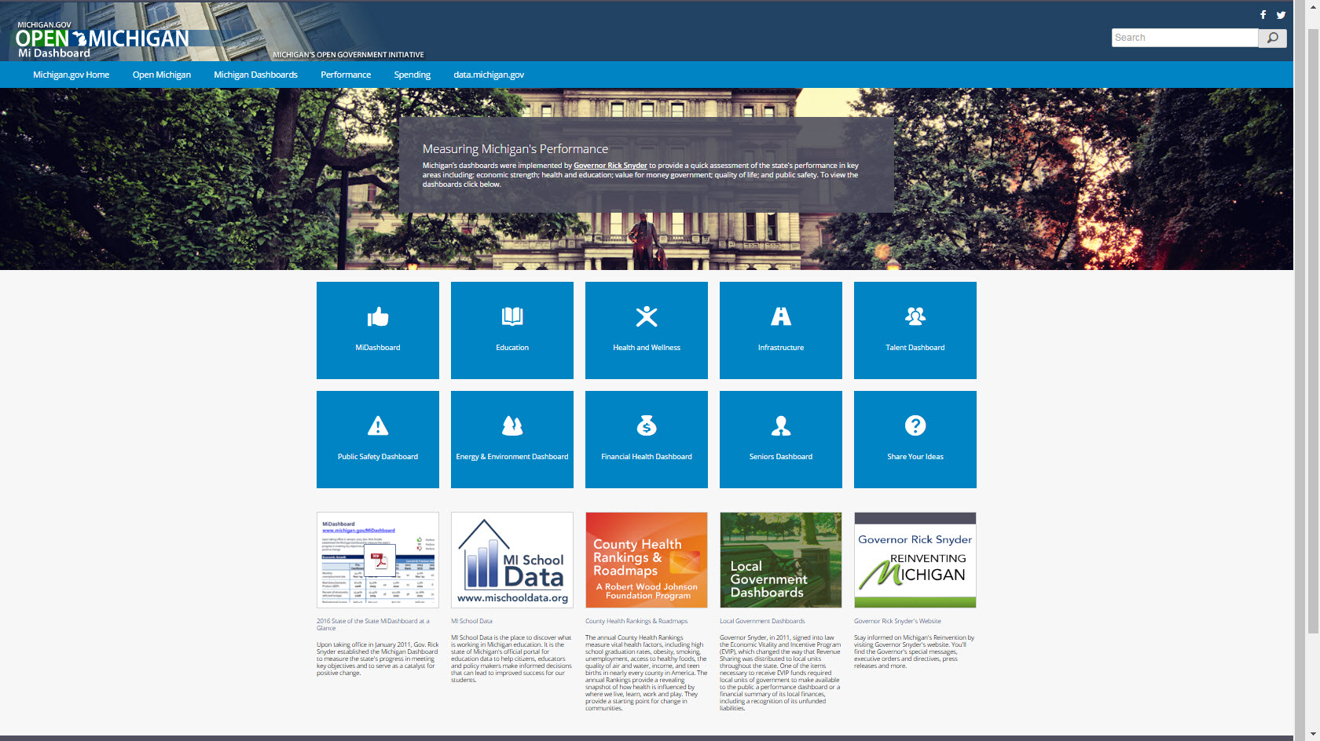
State of Michigan
Current Performance System
Dashboards – Measuring Michigan’s Performance
Nine dashboards focused on policy priorities
Provide assessments of state’s performance in key areas
Governor sets expectations and holds departments accountable
12
12

Slide 13
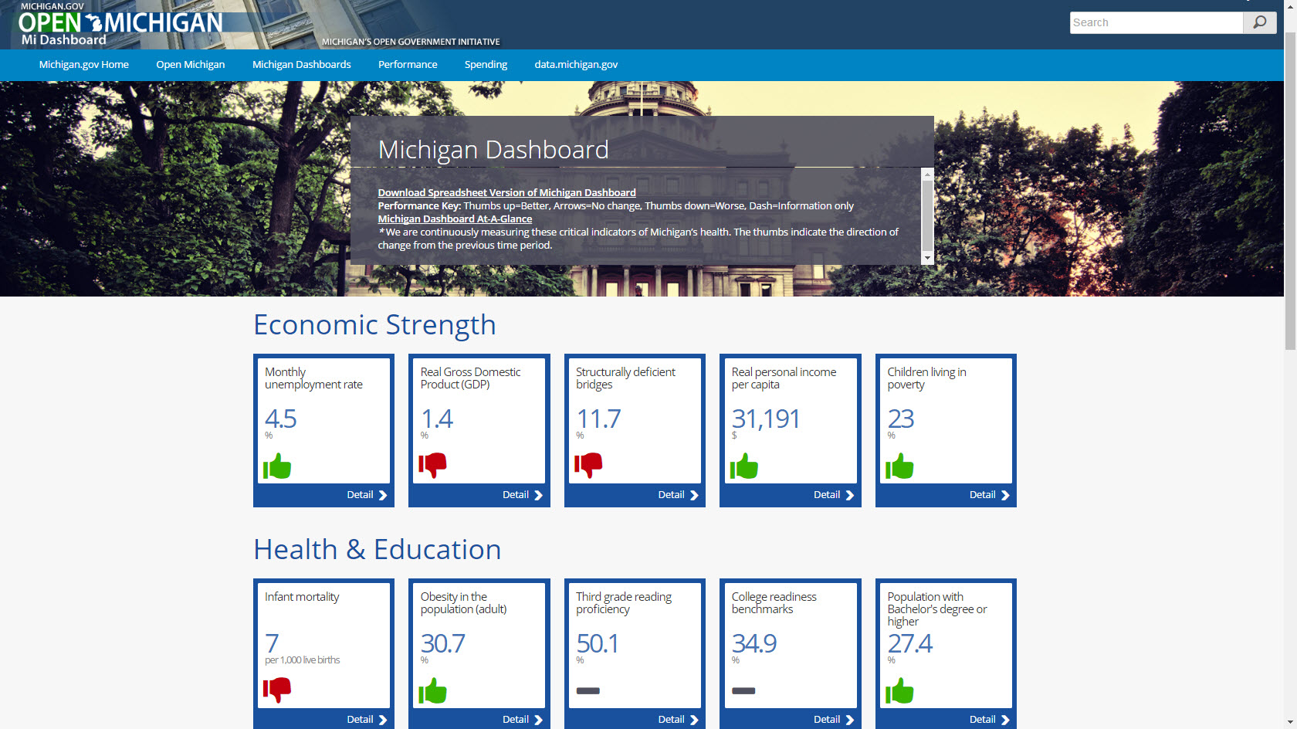
State of Michigan
Michigan Dashboard
13

Slide 14
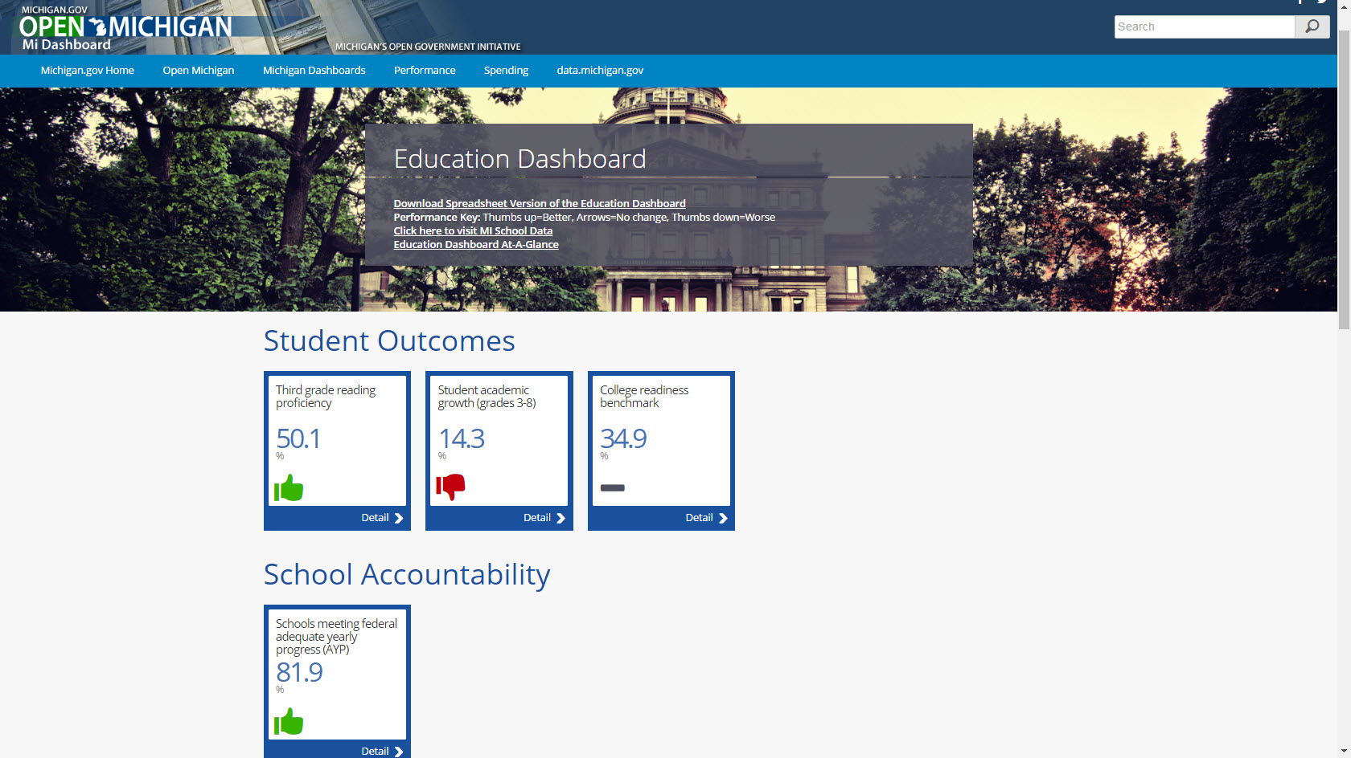
State of Michigan
Education Dashboard
14

Slide 15
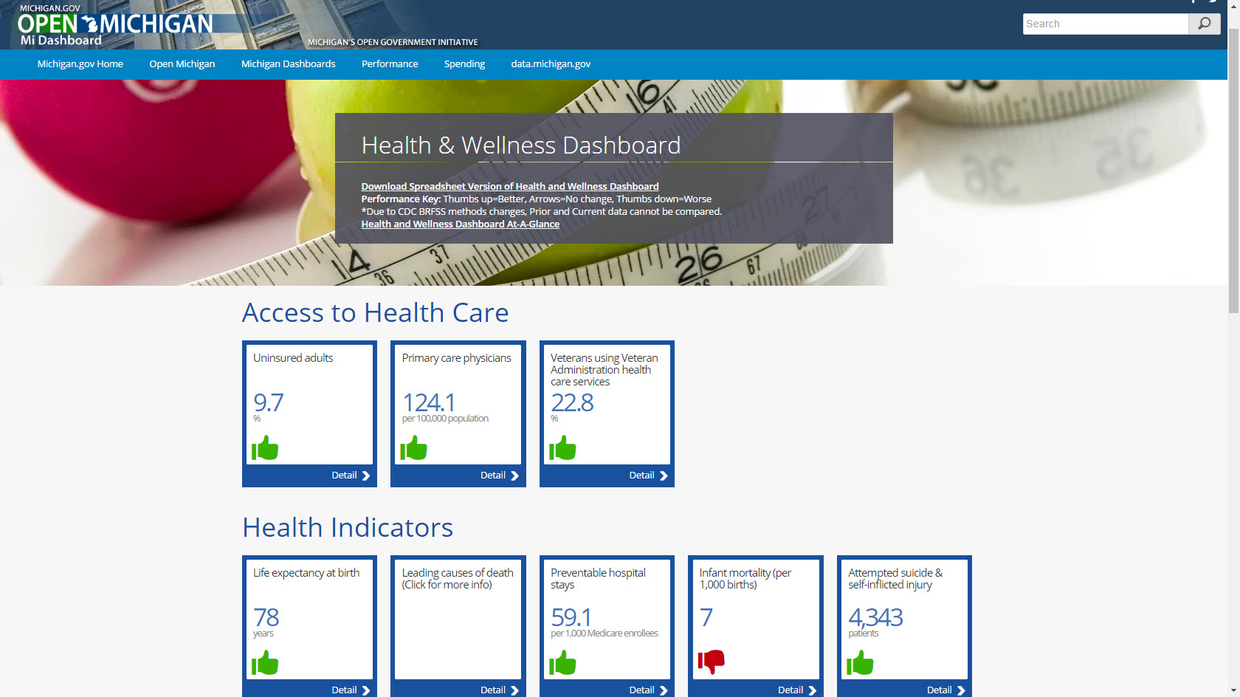
State of Michigan
Health & Wellness Dashboard
15

Slide 16
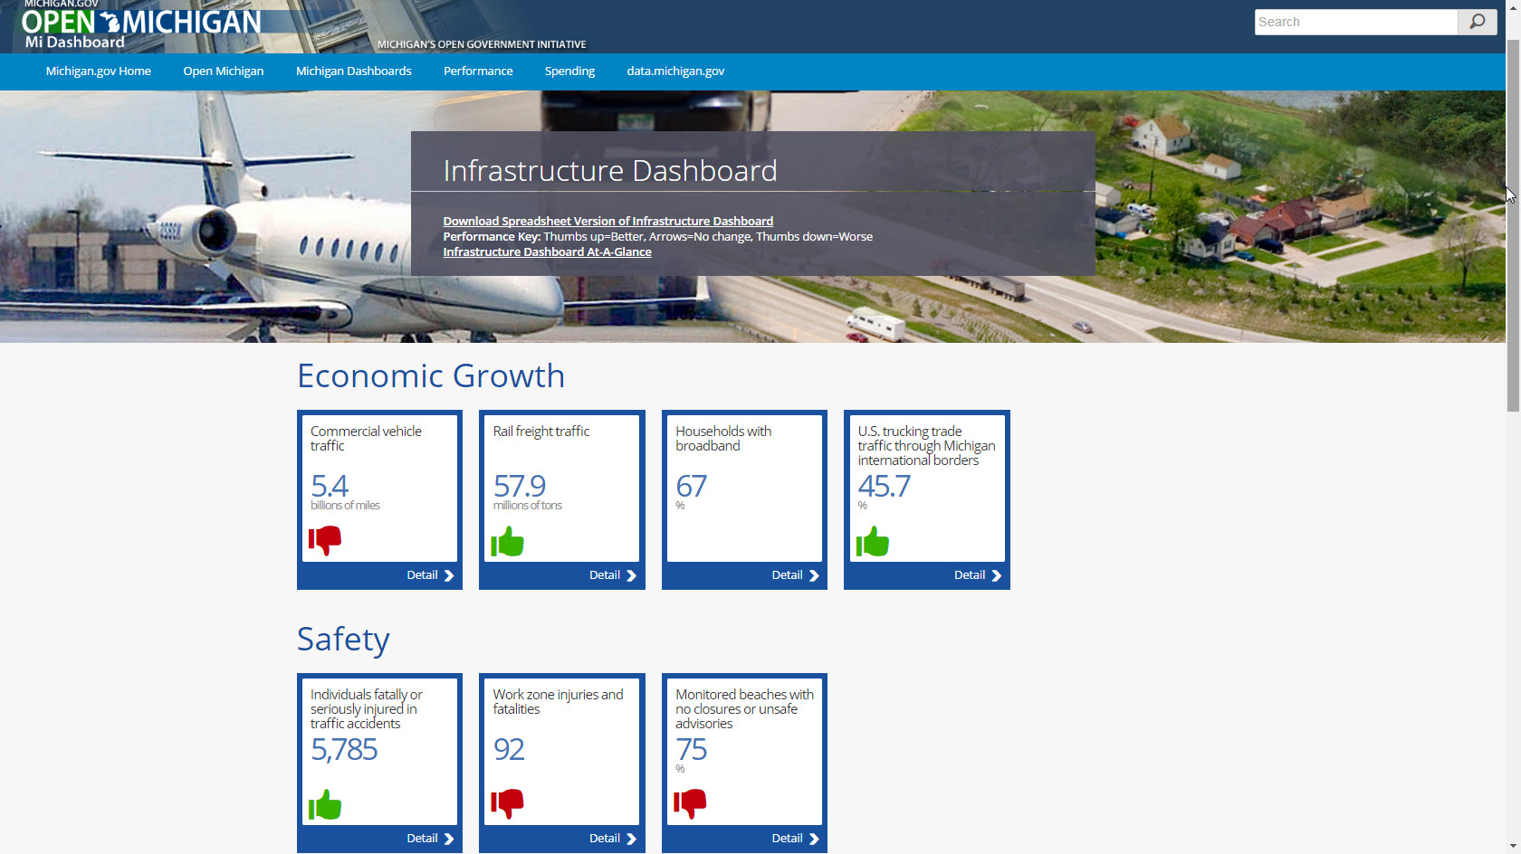
State of Michigan
Infrastructure Dashboard
16

Slide 17
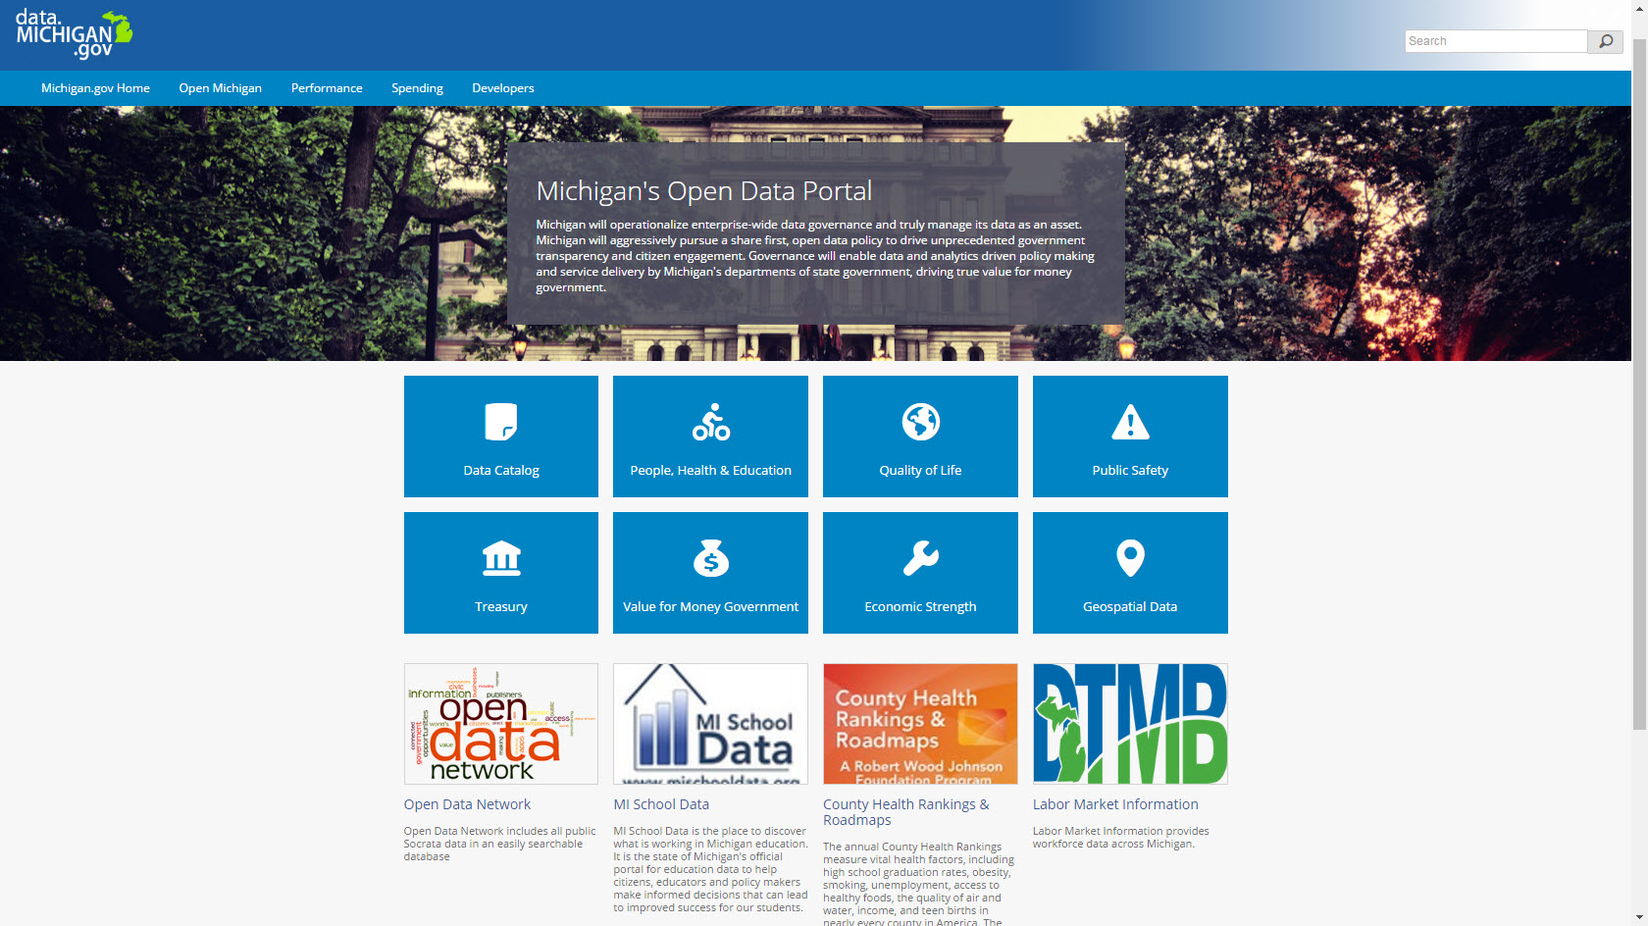
State of Michigan
Current Open Data Portal
17

Slide 18
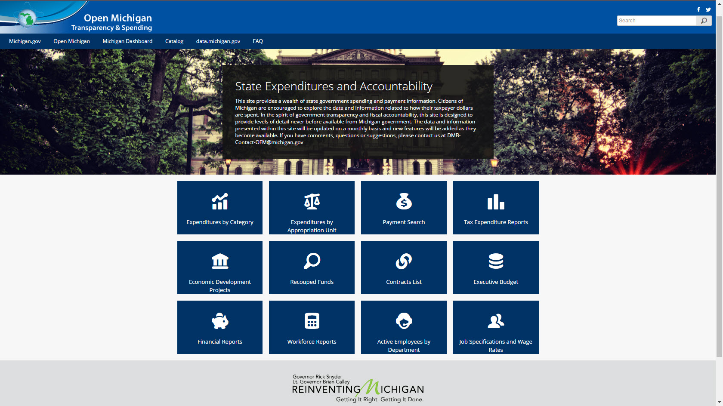
State of Michigan
State Budget Office – Financial Transparency
18

Slide 19
Michigan Roads – Vital Statistics
660 Road Owning Agencies
  State – 13,214 mi
  County – 88,977 mi
  City/village – 20,860 mi
  Private – 13,427 mi (fastest growing segment)

Slide 20

www.michigan.gov/tamc
11 Member Council
  MDOT, Counties, Cities/Villages, MPO/Region, Townships, Data agency
Annual Reporting
  State Transportation Commission
  Legislature
Condition of Michigan’s Roads and Bridges
Multi-Year Road and Bridge Program

Slide 21



Road Funding Accountability
Establishing Common Integrated Data

Slide 22
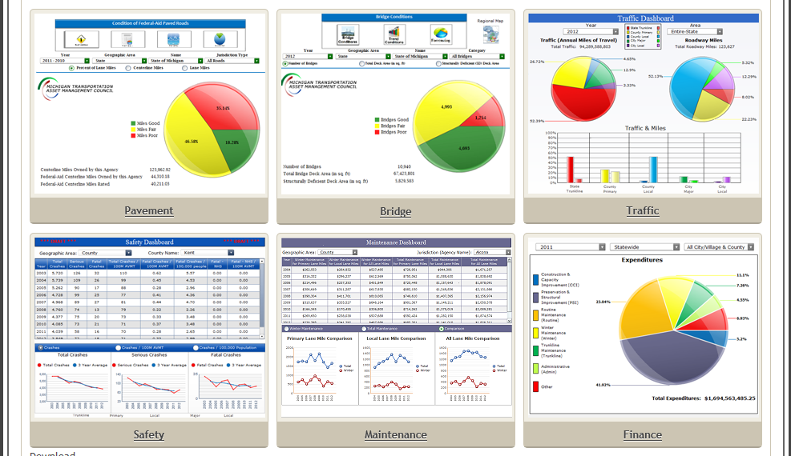
Transportation Performance Dashboard
Pavement
Bridge
Traffic
Safety
Maintenance
Finance

Slide 23
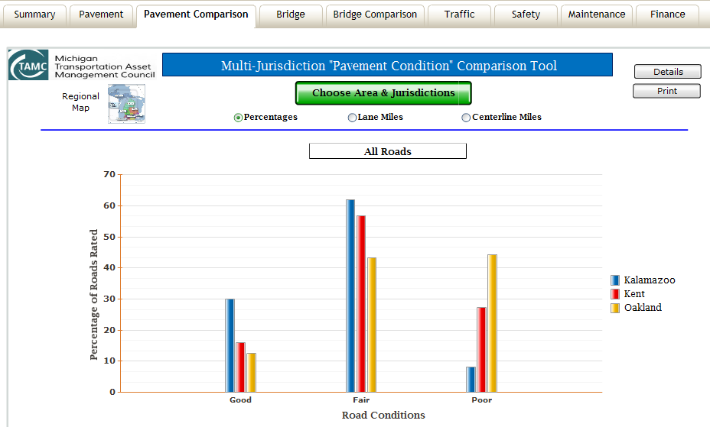
Transparency Across Agencies – Pavement Condition Comparisons

Slide 24
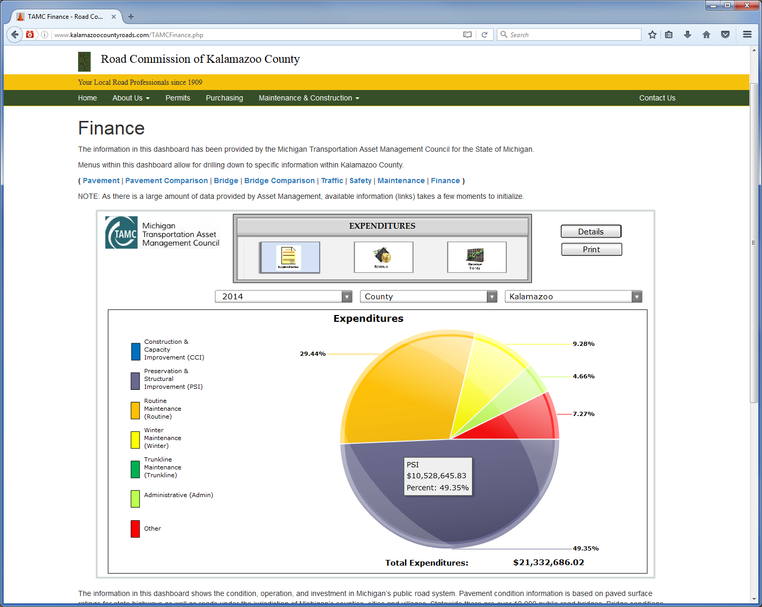
Local Example - Kalamazoo County

Slide 25
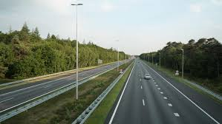
Data Driven Outcome
Over $1.2 Billion annual increase in road funding

